Slide 1
Overall Data Structure
Sales
ID
HouseHoldID
Sale Records
(Date, Brand Code, Brand Name, Dealer Code, Raw Model, SegL1, Segment, Model, ModelID)
Zip Code
Demo
ID
HouseHoldID
Demographics (Numerous Vars)
Vehicles (Make Code, Model Code, Model Year)
Household
HouseHoldID
censusTractID
6 Digit ID but does not match any IDs from the other two datasets!
6 Digit ID matches ID in Demo dataset
Should we focus on ModelID or just SegL1 or Segment?
If we were to work with ModelID, does it have a structure?
Feature Color Coding: Text, Category
Feature Selection Color Coding: Ignore, Keep

Slide 2
Sample Records & Issues :
Sales.HouseHoldId = 4300622 Shows 3 records of registered vehicles
Demo.ID = 4300622 Shows 2 records of registered vehicles
All the features except some features ‘OccupationInputIndividuals’ & ‘InputIndividualEducation’ for these two records are the same. It might show that two adults living in that household both registered for a car.
Comparing these two queries, we could conclude that the number and types of cars registered for that household are not consistent.

Slide 3

Sample Records & Issues :
The code mapping Make and Model for the Demo dataset has not been given; according to the supportive documents it is located at ﻿H:\Sales\IBSME\Enhancement\Data Dictionary.
Assuming the Demo data is the most updated as the time the we are provided with, we might infer some features for Sales Dataset by subtracting the time passed from the purchase event to now ; like age, income maybe .

Slide 4
Sample Records & Issues :
Even though we could make a consistent estimation for time related features (age or income) , for some feature is not possible like marital Status, Dynamic Segmentation, business and education, etc.
The demo data is related to each household , not a family and it reports the demo for the current family living in that household. How could we ensure that we ae talking about the same family . For instance, the Sales data saying that a car was purchased by the household at 2013. How could we ensure that still the same people as demo data reports living in that house. That household could be a rental investment or was sold to another family ?

Slide 5
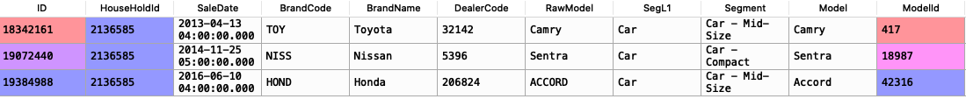
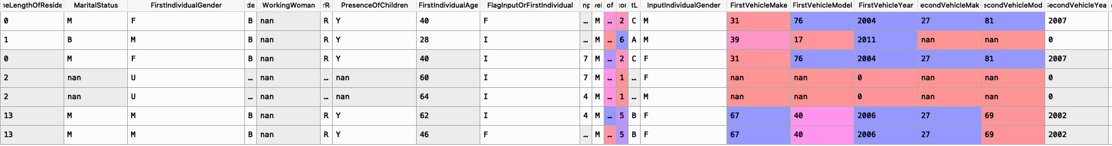
Now Let’s imagine we want to recover just age for a record in Sales (Sales.HouseHoldId = ﻿3487455﻿) with subtracting the gap
As the first column shows ; length of residency , we could find at least 4 different families have been living there. Should
I take just the first one ?
Lots of if scenarios !!!!!

Slide 6
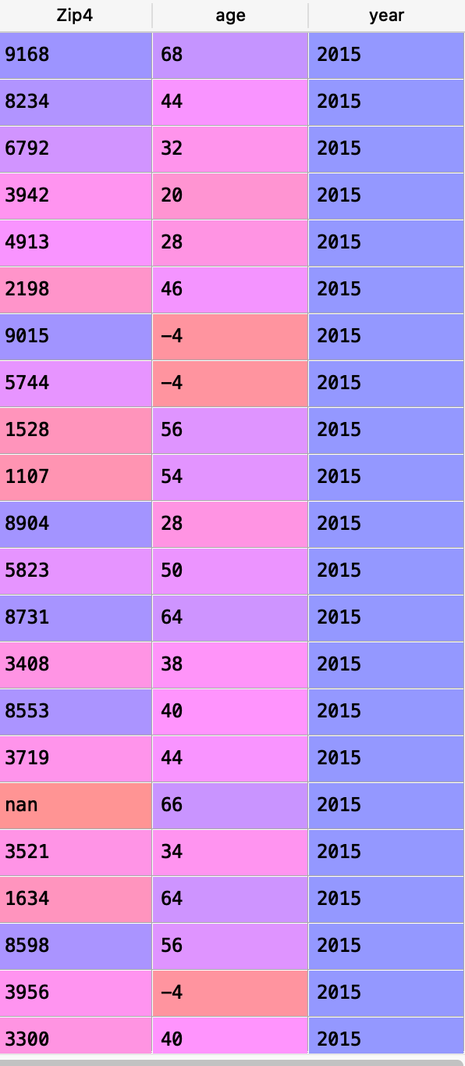
If the age of each individual in the dataset is supposed to be retrieved based on inference (gap) , two problems arise :
1- the number of individuals at each household is different , they are from different sex and also children from different sexes are yet another variables , meaning that , I don’t know how many features I need to prepare beforehand unless I make some bins .
2- Another problem is that the data found in demo is not always related to a household (length of stay ) and still I don’t know which one I need to take . It is computatble if we assume they are in order , more over , still the inconsistency is the matter .
()

Slide 7
Below , we can see that the first household is the female as the “FisrtIndividualGender” but the age is zero and the second household male with zero length of stay
Also we could find some inconsistency so that , it is listed the first individual as Female but some other individuals in the household listed not as a ….
Mean , duration from the last purchase , old of vehicles , quarterly representation
Feature .

